Slide 1

Intro to Concurrency
REVISE: see feedback
CS532: OS Foundations
Lab Assignment
email address: parth2@pdx.edu
partner’s email address:

Slide 2
Instructions: Make a copy of this document, move your copy to your submissions folder and fill the document with your responses. Use the space on each slide to show your responses, and add additional slides as needed.
When ready for grading: complete the lab assignment submission form and include a link to your filled document

Slide 3
helloT.c
Find the helloT.c program linked from the unit course plan document. Read and understand the source code. Read the man pages for all of the pthreads API calls used in the program so that you fully understand the program.
Build and run helloT and confirm that the output is similar to what is described in the source code.

Slide 4
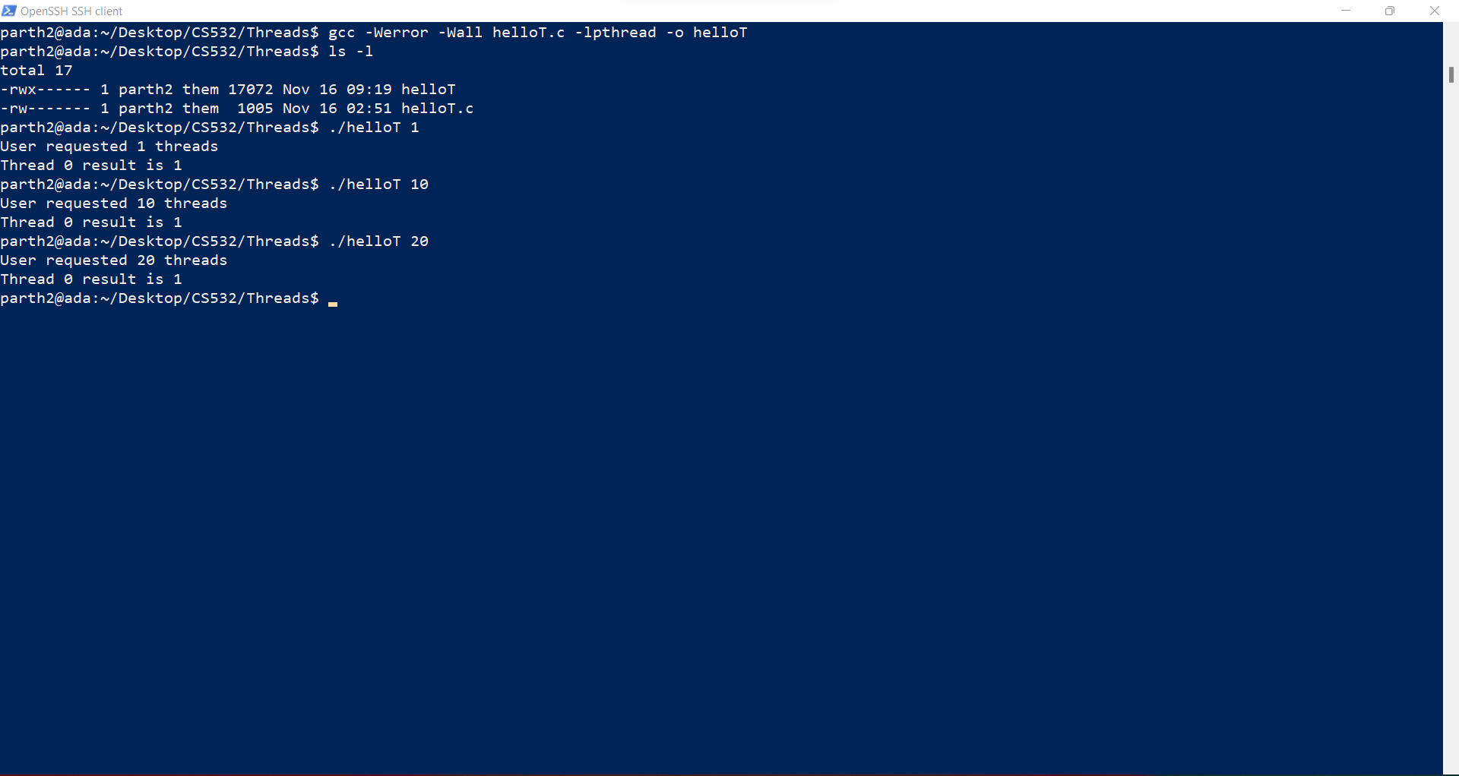

Slide 5
1. Modify your copy of helloT.c so that it creates the correct number of threads and that each thread computes its own unique factorial. Test the code with various input values.
Name your fixed version helloT2.c, upload it to your submissions folder and provide a link to it here (the link below is incorrect and must be changed to link to your helloT2.c program)
https://drive.google.com/file/d/1MvH25yAQ_HWADUzBZz3lGmKEhn76JZa1/view?usp=sharing
Code needs revision. See next slide.

Slide 6
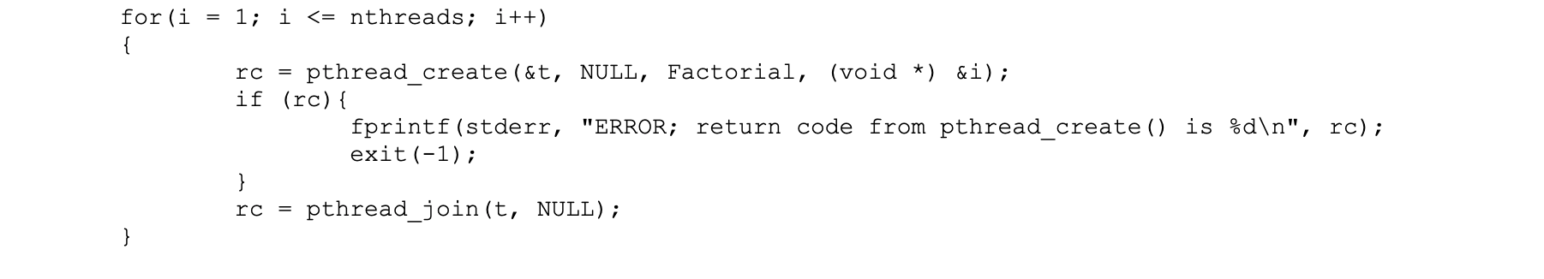
This code might produce the correct results, but it is not acceptable because it is a sequential program not a concurrent program. It joins with each thread immediately after creation and before creation of the next thread, so the child threads never run concurrently. This leads to poor performance, too.

Slide 7
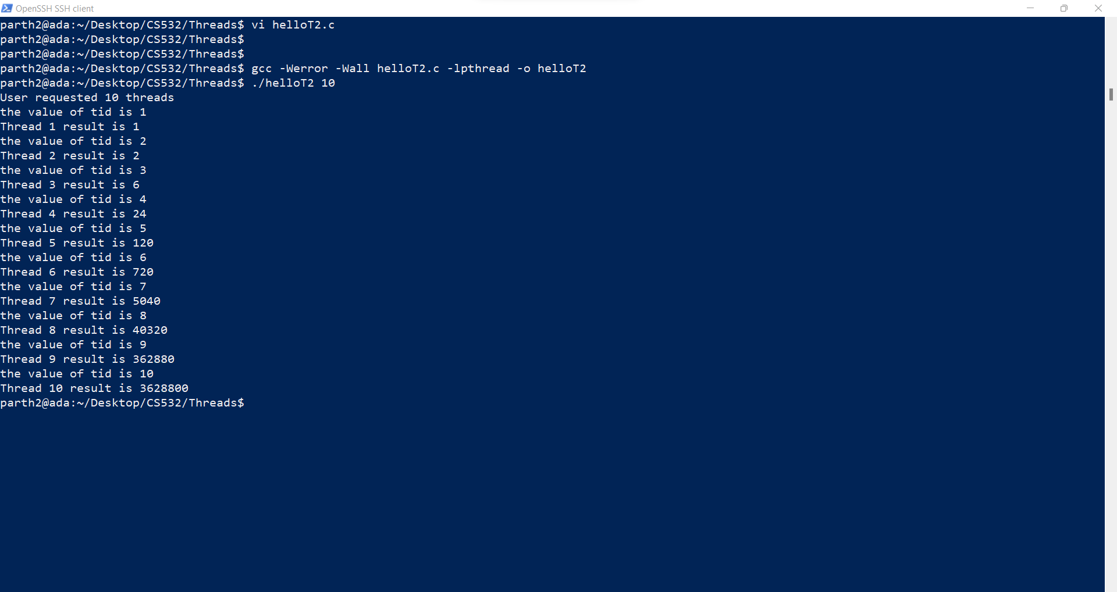

Slide 8
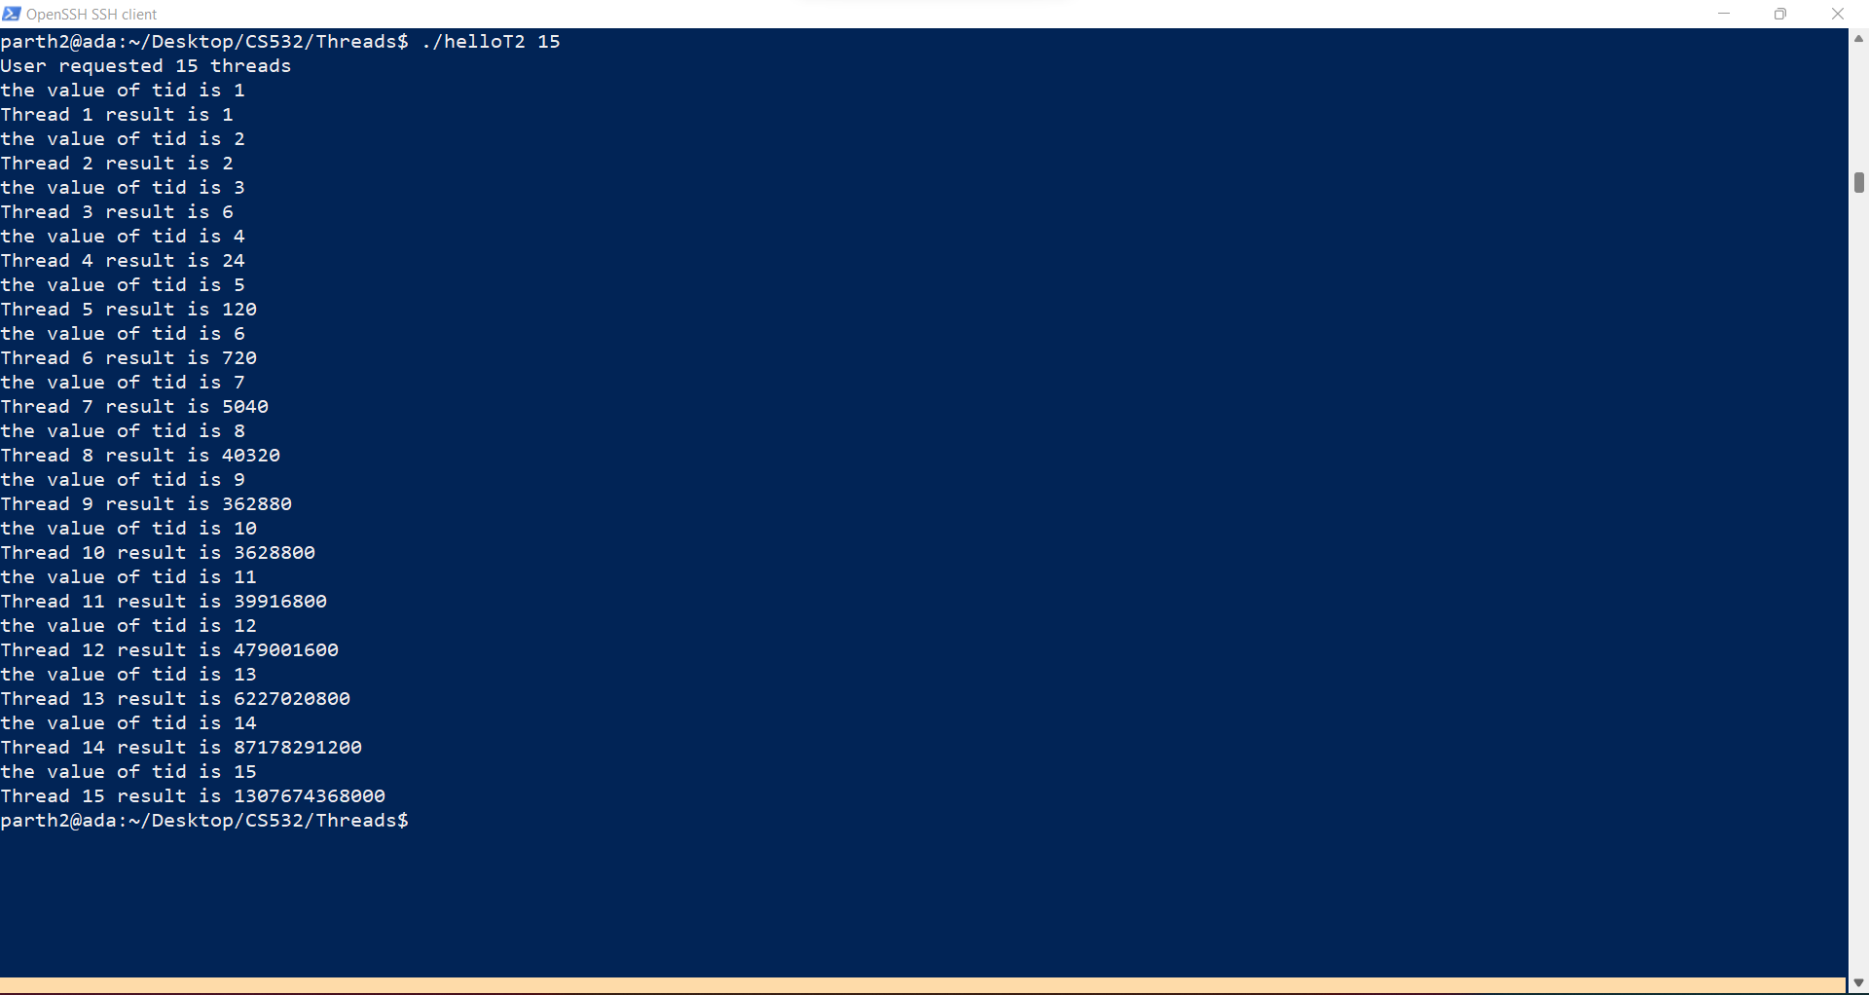

Slide 9
#include <pthread.h>
#include <stdio.h>
#include <stdlib.h>
#include <unistd.h>
#define MAXTHREADS 50
#define SLEEPTIME 5
void *Factorial(void *tidptr)
{
sleep(SLEEPTIME);
int tid = * ((int*) tidptr);
printf("the value of tid is %d\n",tid);
if (tid > 20) {
fprintf(stderr, "ERROR: thread %d exit to avoid long long overflow\n", tid);
return NULL;
}
unsigned long long factorial = 1;
for (int j = 1; j <= tid; j++) {
factorial *= j;
}
printf("Thread %d result is %llu\n", tid, factorial);
return NULL;
}

Slide 10
int main(int argc, char *argv[])
{
if (argc != 2) {
fprintf(stderr, "USAGE: helloT <nthreads>\n");
exit(-1);
}
int nthreads = atoi(argv[1]);
if (nthreads < 1) {
fprintf(stderr, "ERROR: numthreads must be >= 1\n");
exit(-1);
}
printf("User requested %d threads\n", nthreads);
int rc;
pthread_t t;
int i = 0;
for(i = 1; i <= nthreads; i++)
{
rc = pthread_create(&t, NULL, Factorial, (void *) &i);
if (rc){
fprintf(stderr, "ERROR; return code from pthread_create() is %d\n", rc);
exit(-1);
}

Slide 11
rc = pthread_join(t, NULL);
}
exit(0);
}

Slide 12
2. test your helloT program by running the following sequence of commands on your linux system:
rm -f helloT2_out.txt date > helloT2_out.txt
echo ./helloT2 1 >> helloT2_out.txt
./helloT2 1 >> helloT2_out.txt
echo ./helloT2 5 >> helloT2_out.txt
./helloT2 5 >> helloT2_out.txt
echo ./helloT2 15 >> helloT2_out.txt
./helloT2 15 >> helloT2_out.txt
echo ./helloT2 25 >> helloT2_out.txt
./helloT2 25 >> helloT2_out.txt
date >> helloT2_out.txt
Inspect the helloT2_out.txt file to make sure that the program is running correctly. Upload your helloT2_out.txt file to your submission folder and provide a link to it here: https://drive.google.com/file/d/1MvH25yAQ_HWADUzBZz3lGmKEhn76JZa1/view?usp=sharing
The link listed below seems to link to the code not the output.
The output shown in the subsequent slides shows that it took nearly 15 minutes to run the script. This is very slow, it should be able to run in about 30 seconds. The poor performance is due to the issue described previously (it is a sequential program).

Slide 13
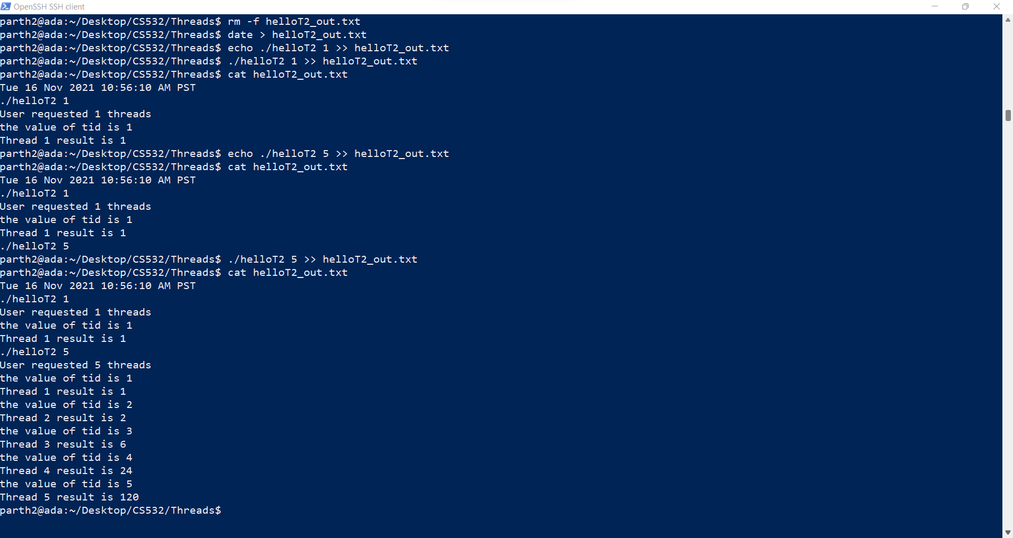

Slide 14
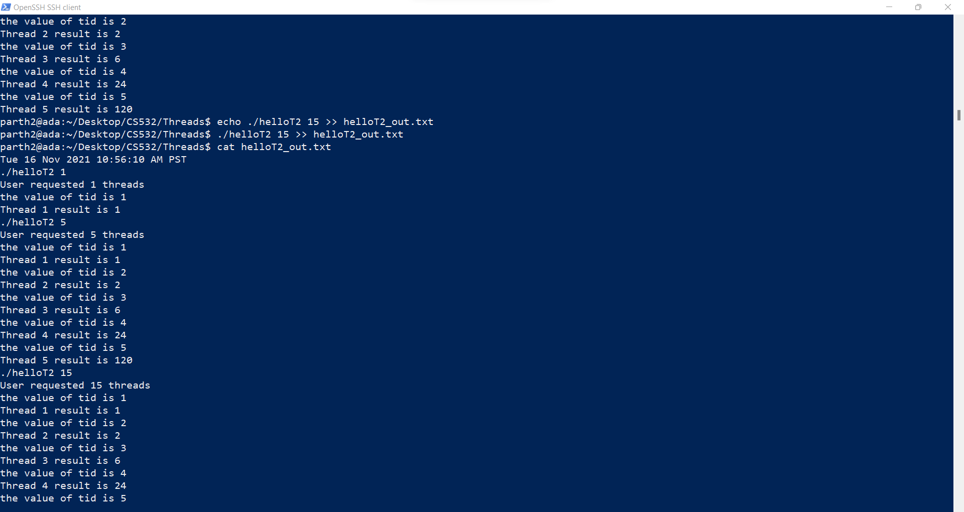

Slide 15
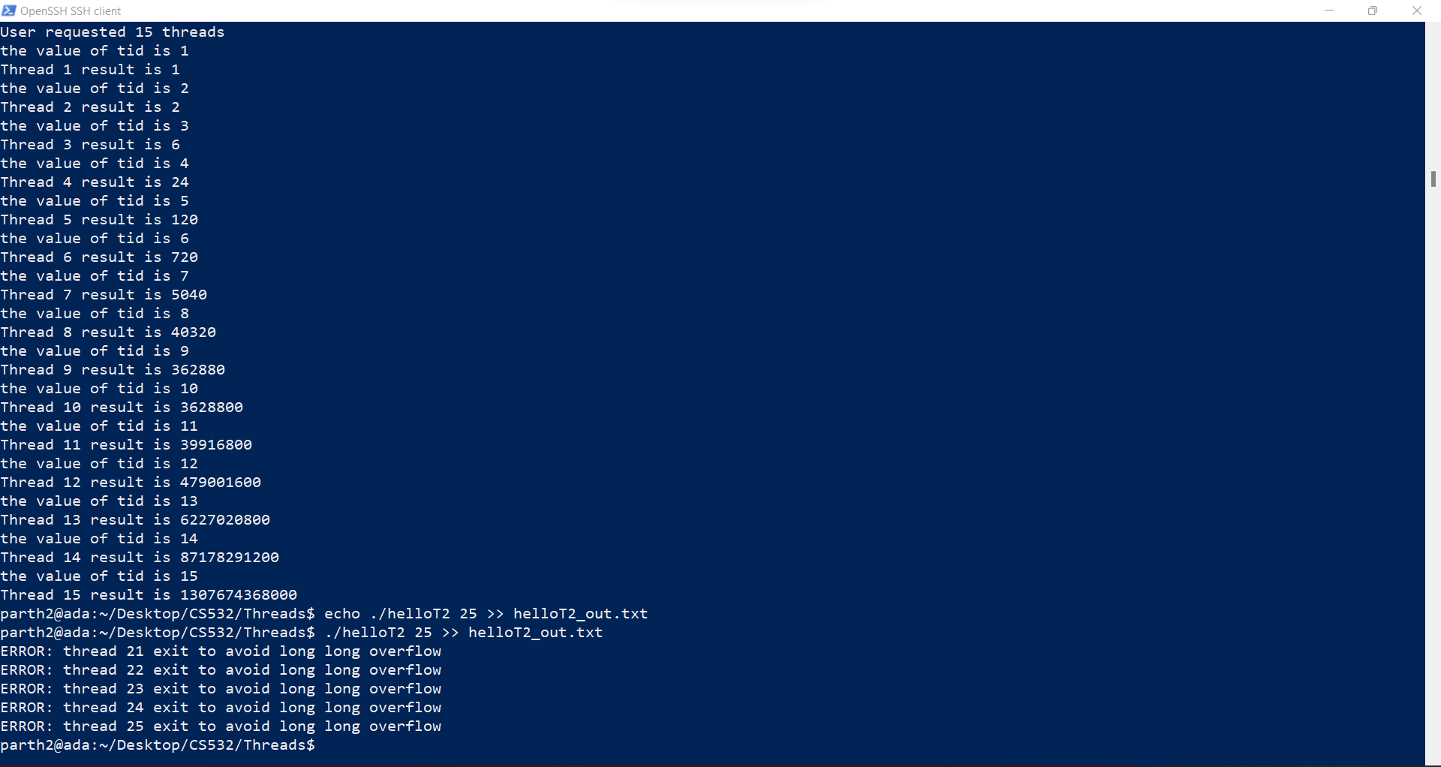

Slide 16
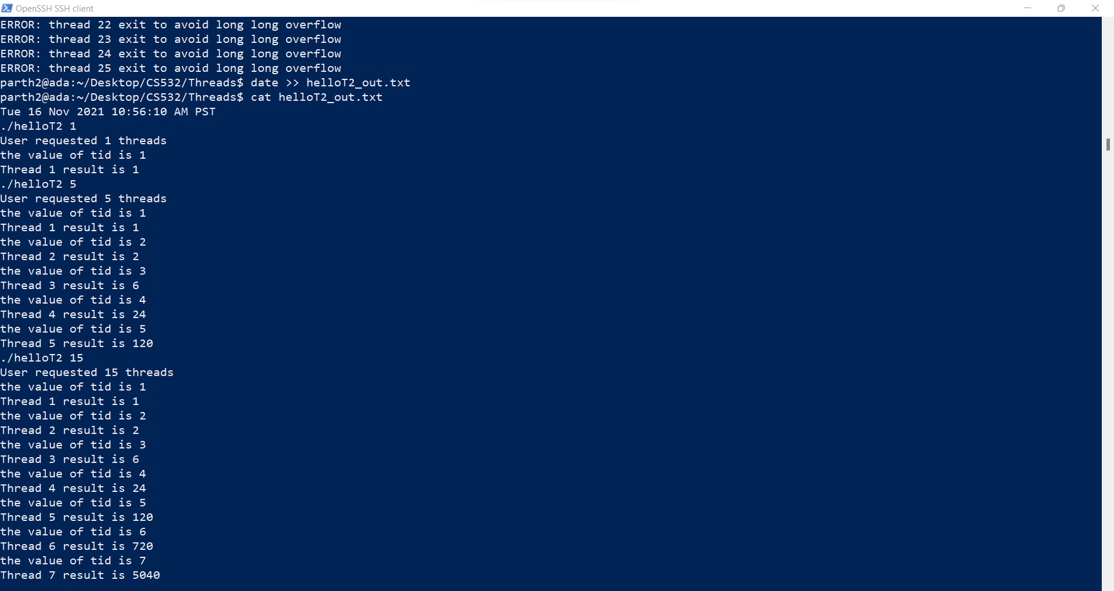

Slide 18
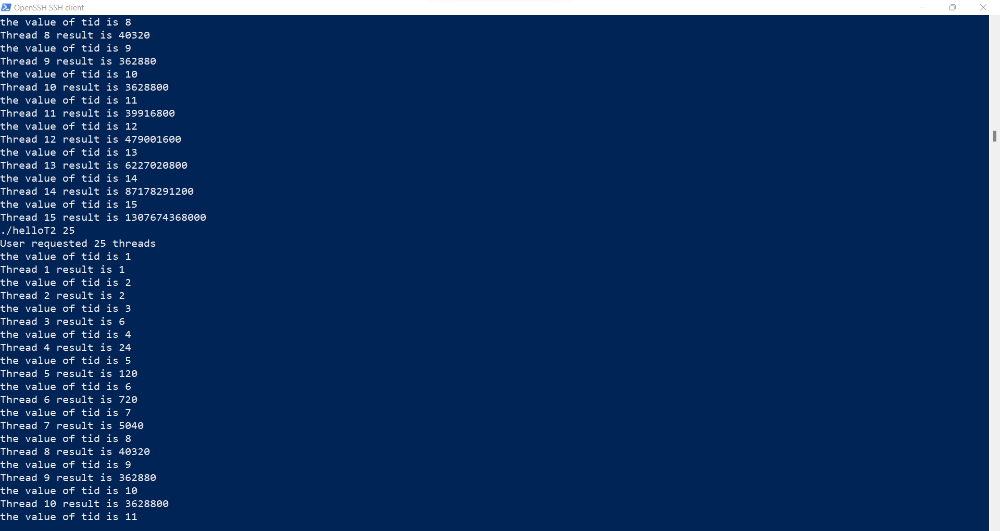

Slide 19
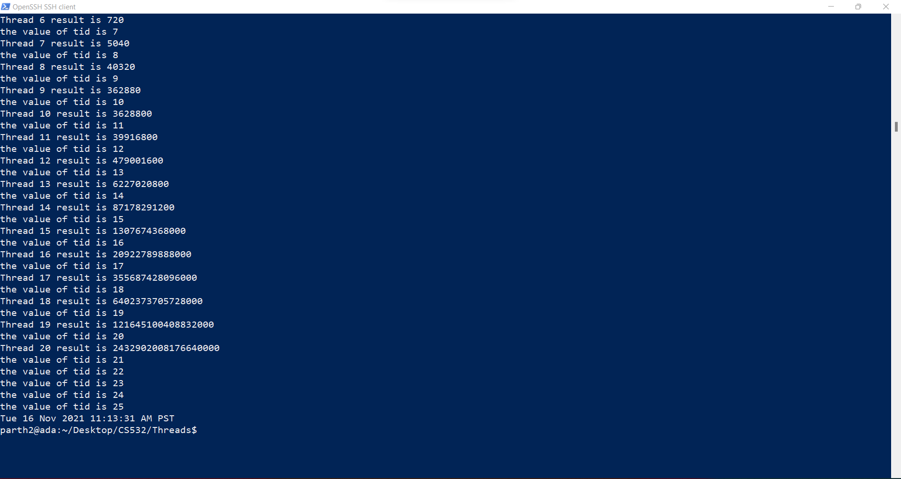

Slide 20
3. Were any parts of this assignment particularly difficult for you? If so, describe the most difficult part of the assignment, for example, the part that required the most effort for you.
The most effort was required to modify the helloT program to conform to the requirements.

Slide 21
4. Before this assignment had you any previous experience writing concurrent software? If yes, then briefly describe your previous experiences.
Yes, I have worked on multi-threaded systems in the past using JAVA as the programming language. I have worked on multi-threaded systems in my professional career with TCS where i had developed concurrent applications using JAVA, Apache Kafka and Apache Ignite.

